Slide 1





sing
LET LIFE
NATIONAL
MONTH

Slide 2
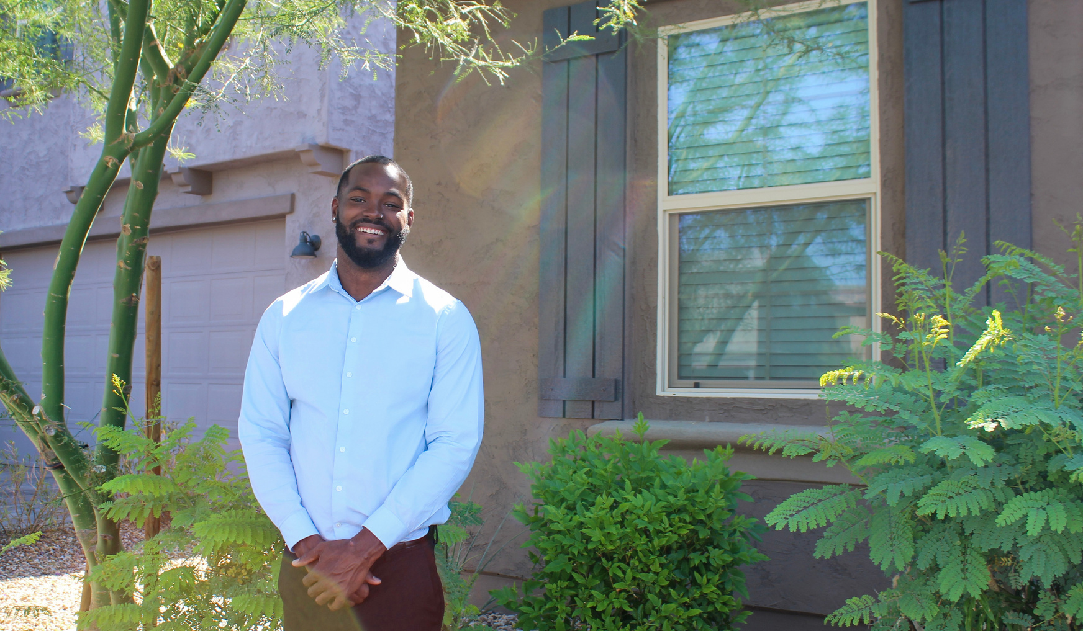
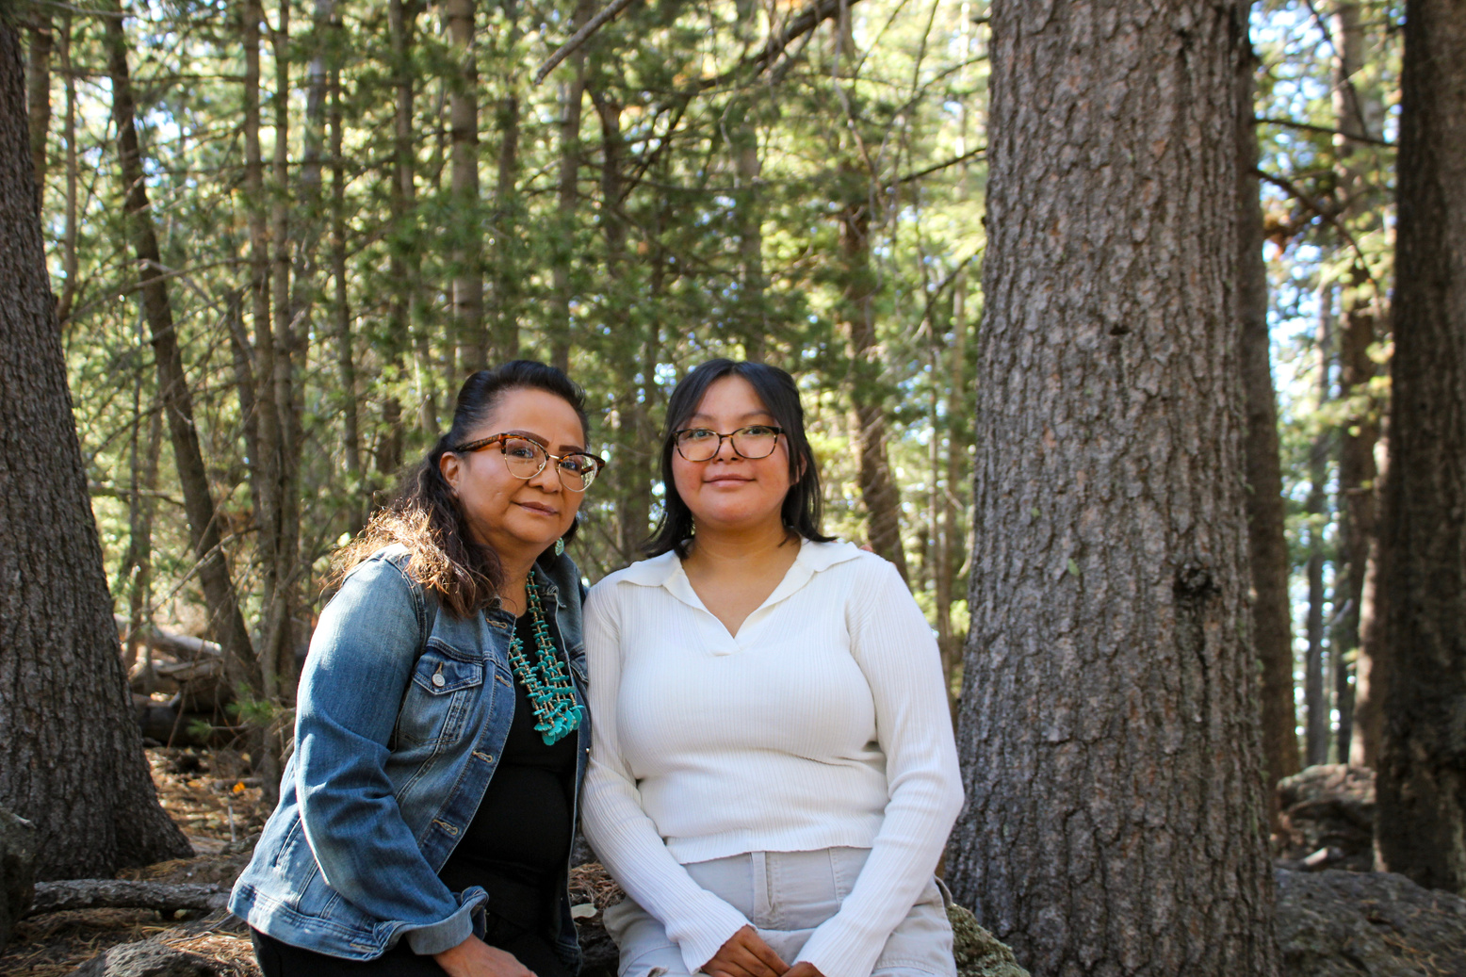
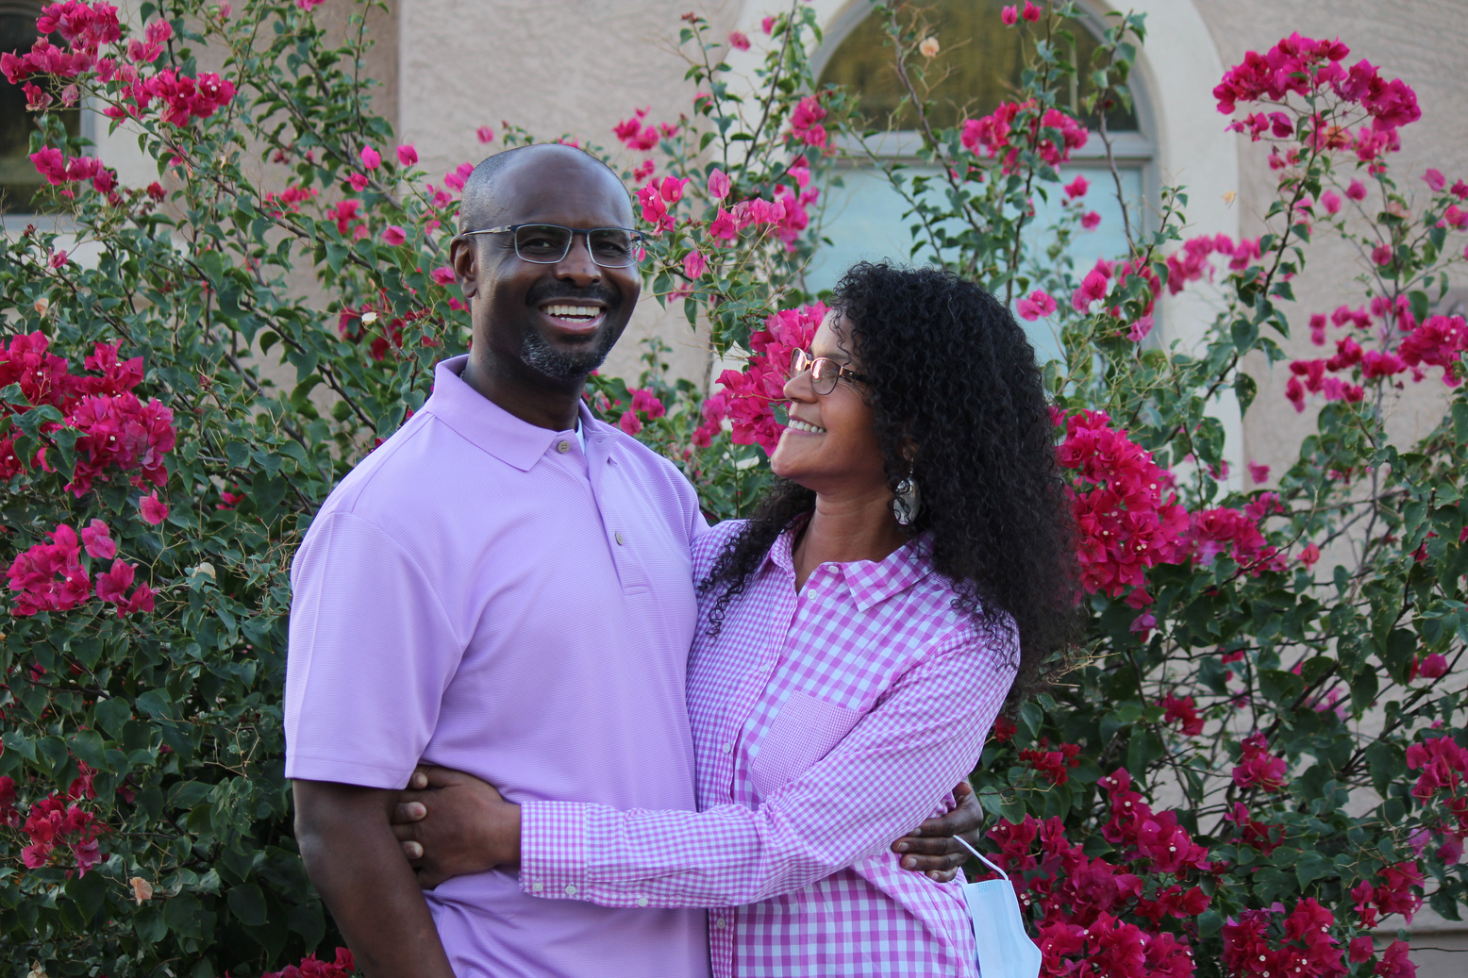
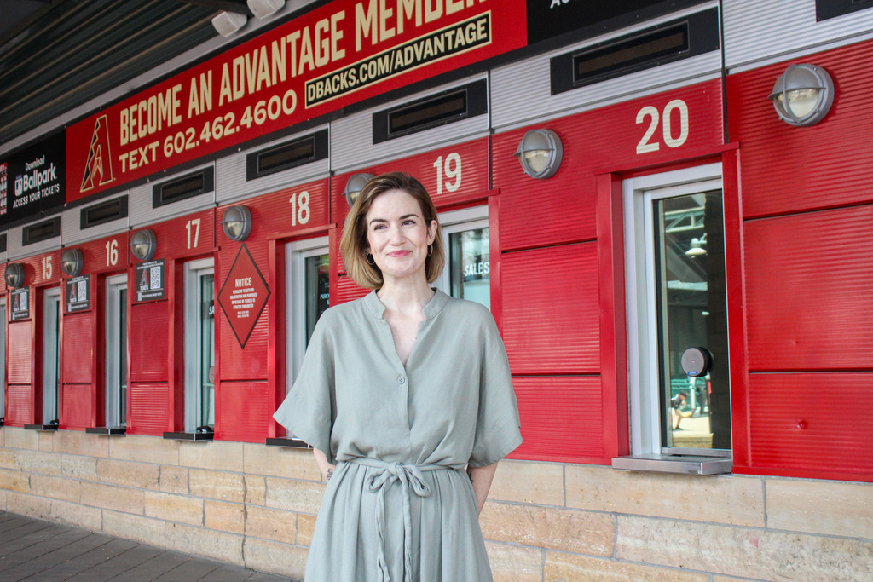
second chances
DONATION PROVIDES
Jazrome “AJ” Coulter,
kidney recipient
Vangie Yazzie (l) & Makenna Jones, cornea recipient (r)
Claire Filson, heart recipient
NATIONAL
MONTH

Slide 3
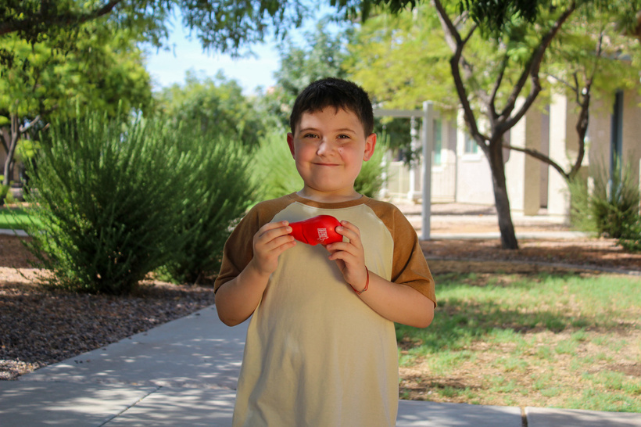
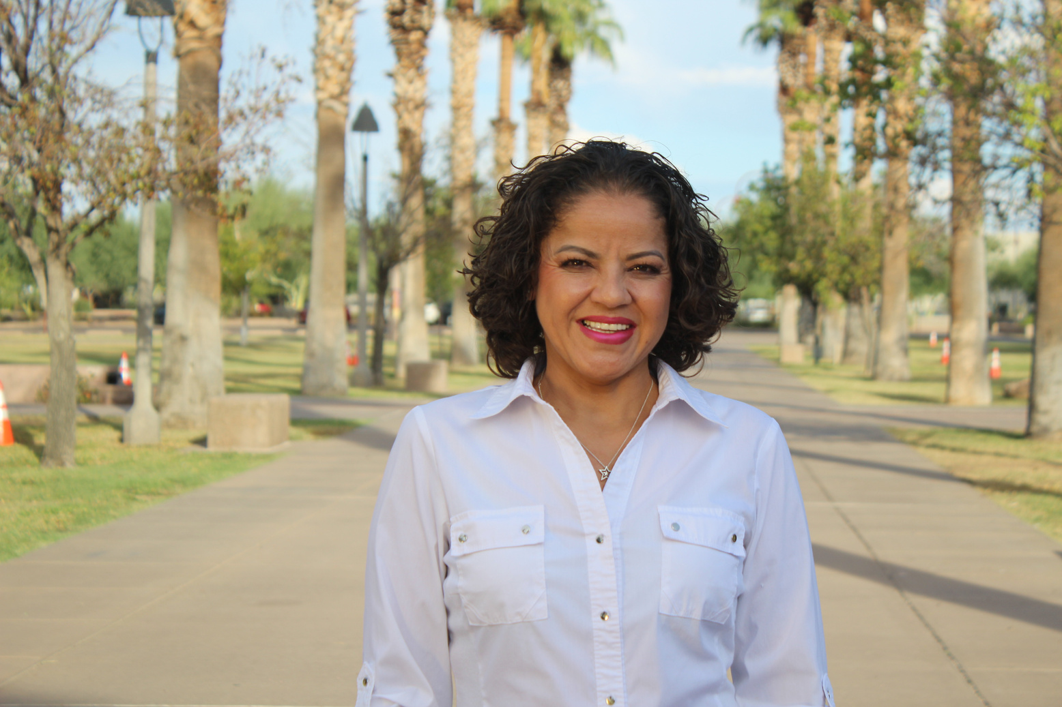
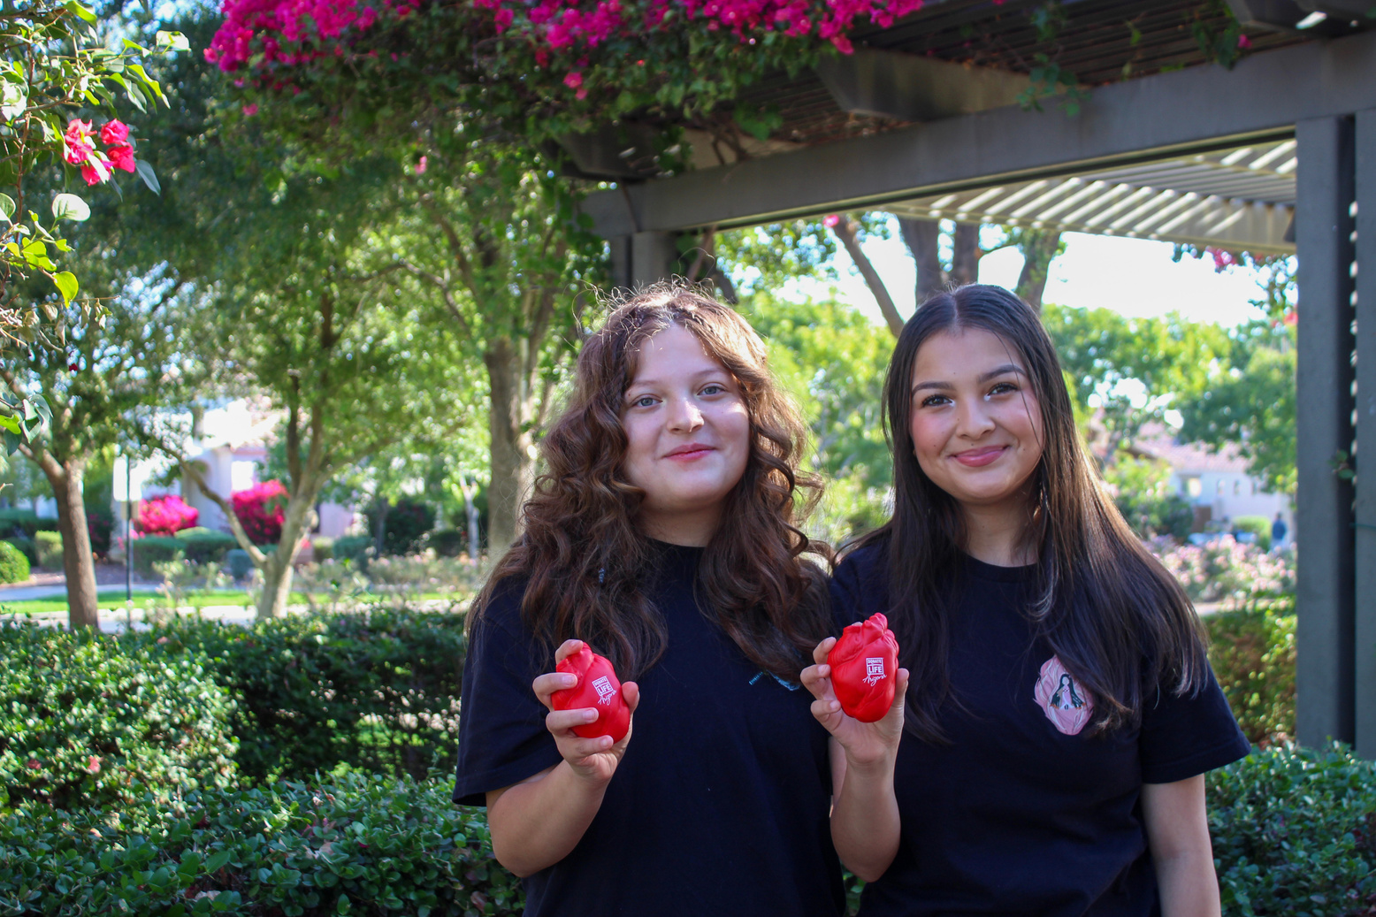
second chances
DONATION PROVIDES
Valen Krasnov, liver recipient
Adina (l) & Andrea Lopez (r),
heart recipients
Nancy Castillo, kidney recipient
NATIONAL
MONTH

Slide 4
second chances
DONATION PROVIDES
“I SEE LIFE FROM A DIFFERENT PERSPECTIVE NOW AND HAVE BECOME MORE GRATEFUL FOR THE LITTLE MOMENTS IN LIFE.”
Nancy Castillo, kidney recipient
NATIONAL
MONTH

